Slide 1
Platform Thread and Virtual Thread

Slide 2
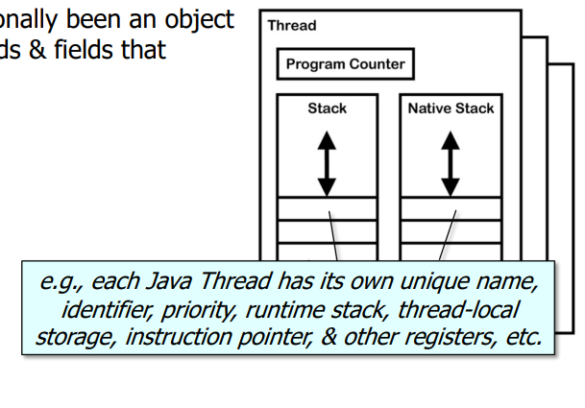
A Java Thread has traditionally been an object containing various methods & fields that constitute its “state”

Slide 3
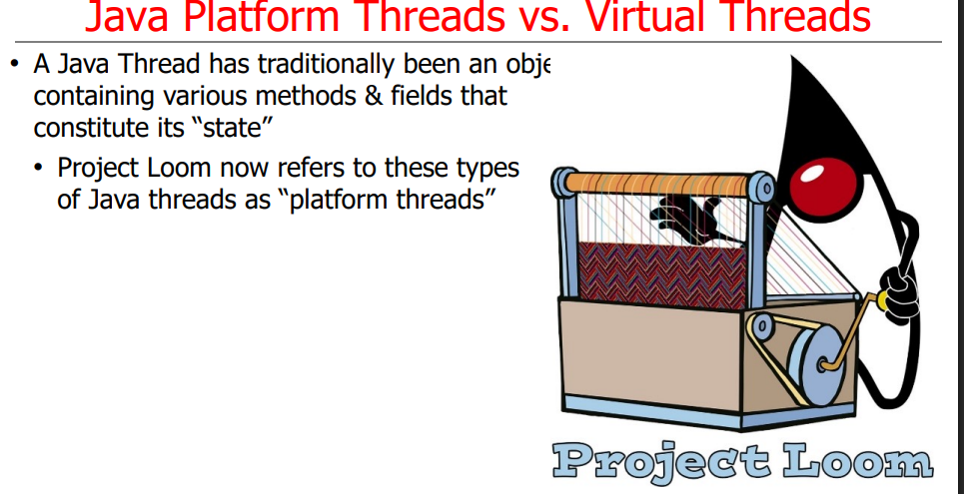

Slide 4
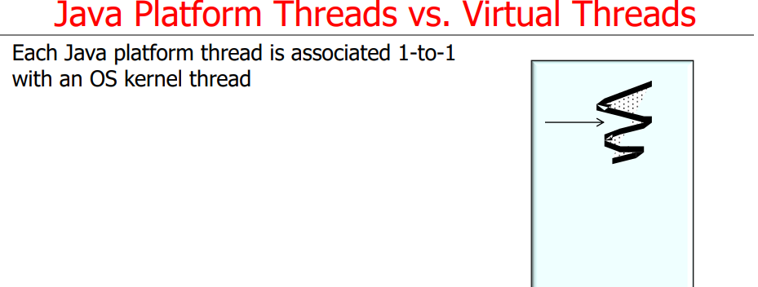

Slide 5
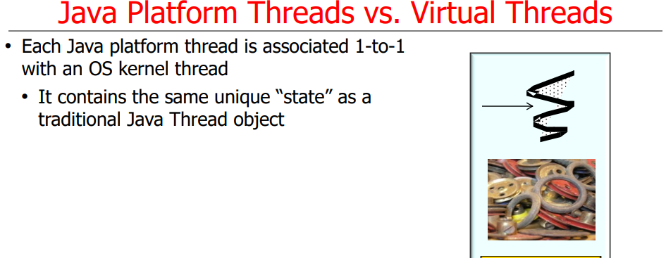

Slide 6
Virtual Thread

Slide 7
Virtual Thread
In contrast, each Java virtual thread is a “lightweight” concurrency object

Slide 8
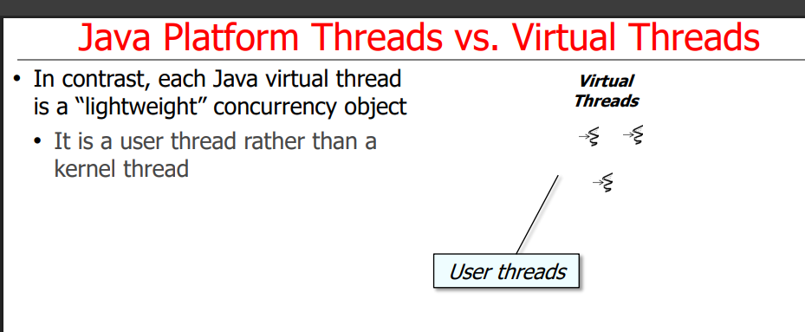

Slide 9
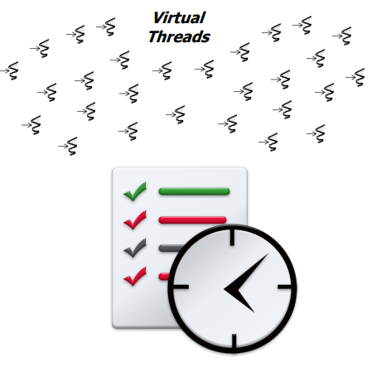
In contrast, each Java virtual thread is a “lightweight” concurrency object
• It is a user thread rather than a kernel thread
• It is scheduled by the Java execution environment rather than the underlying OS
• A very large # of virtual threads can therefore be created

Slide 10
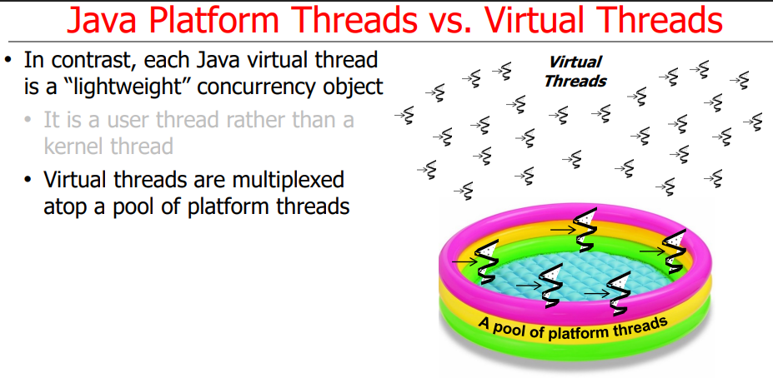

Slide 11
Creation Platform Thread

Slide 12
Platform thread example
Example
class MyTh implements Runnable
{
public void run()
{
System.out.println("hello");
}
}
class MyThPl
{
public static void main(String ar[])
{
MyTh r=new MyTh();
Thread t= Thread.ofPlatform().start(r);
}
}
output
hello

Slide 13
Platform thread example
class MyTh implements Runnable
{
public void run()
{
System.out.println("hello unstarted");
}
}
class MyThPlTwo
{
public static void main(String ar[])
{
MyTh r=new MyTh();
Thread t= Thread.ofPlatform().unstarted(r);
t.start();
}
}
Output
hello unstarted

Slide 14
Creating virtual thread

Slide 15
class MyVirtual{
public static void main(String ar[]){
Thread thread = Thread.ofVirtual().start(() -> System.out.println("Hello World!! I am Virtual Thread"));
try{thread.join();}catch(Exception ex){}
}
}
output
Hello World!! I am Virtual Thread

Slide 16
class MyVirtualThree implements Runnable
{
public void run()
{
System.out.println("virtual thread");
}
public static void main(String ar[])
{
MyVirtualTwo obr = new MyVirtualTwo();
Thread t=Thread.ofVirtual().start(obr);
try{t.join();}catch(Exception ex){System.out.println(ex);}
}
}
Output
virtual thread

